Slide 1
Analysis on Life Expectancy
Shweta Dutta
18/11/2019

Slide 2
Outline
Life Expectancy and Purpose
Data Description
Data Exploration – Numerical
Data Exploration – Graphical
Scatter Plots
Linear Model Application
Further Model Fitting
Final Model Selection
Validity of Assumption
Residual Analysis Plots
Drawback – Influence Observations
Further Studies

Slide 3
Life Expectancy and Purpose
Life Expectancy – A statistical measure of the average time a person is expected to live based on his birth year, current age and other demographic factors.
Factors that affect Life Expectancy - Socioeconomic status, Income, Quality of health and ability of people to access it, Health behaviors, Immunization, Environment etc.
Questions -
Does various predicting factors affect the Life expectancy and which are those predicting variables?
Should a country with a lower life expectancy value increase its healthcare facilities in order to improve its average lifespan?
How does Infant and Adult mortality rates affect life expectancy?
Does Life Expectancy have any effect on eating habits, lifestyle, exercise, smoking, alcohol consumption etc.?
What is the impact of immunization coverage and schooling on the lifespan of humans?
Do densely populated countries tend to have lower life expectancy?
Purpose – Knowing the predictor variables that affect Life Expectancy of a country will help us to predict the future Life Expectancy of that country.

Slide 4
DATA DESCRIPTION
Source – Global Health Observatory (GHO) under WHO
Data from year 2000 - 2015 for 193 countries on 22 variables
Number of Variables – 22
Categorical Variables: Country, Year, Status – Developing/ Non Developing
Real Variables: Life Expectancy in age (LM), Adult mortality rates (AM), Number of Infant deaths (ID), Alcohol consumption (A), Percentage Expenditure (PE), Hepatitis B immunization coverage (HB), Number of reported cases of Measles (M), BMI, Number of Under 5 deaths (U5D), Polio immunization coverage (P), Total Expenditure (TE), Diphtheria immunization coverage (D), Number of deaths due to HIV/AIDS (HIV), GDP, Population (Popl), Thinness prevalence among 1-19 years (T1_19), Thinness prevalence among 5-9 years (T5_9), Income Composition of resources (I), Number of years of schooling (S)
Initial Data
2398 observations
193 countries
Missing Values – Multiple
Replaced Missing Values of Variables by their mean, for each country
Still, certain less known countries had no values for certain variables or had values for only 1 year – Dropped those observations
Final Data
2128 observations
133 countries
Missing Values - None

Slide 5
DATA EXPLORATION - NUMERical
From 2000 to 2015, average Life Expectancy has increased from 65.47 to 70.6, with decrease in variation from 10.46 to 7.96.
Least average Life Expectancy – 46.112 in Sierra Leone.
Least variation in Seychelles (0.39) and Highest variation in Botswana (7.32).
5 countries has <50 Life Expectancy – Angola, Central African Republic, Lesotho, Malawi, Sierra Leone.
Highest average Life Expectancy - 82.52 in Sweden followed by 82.23 in France.

Slide 6
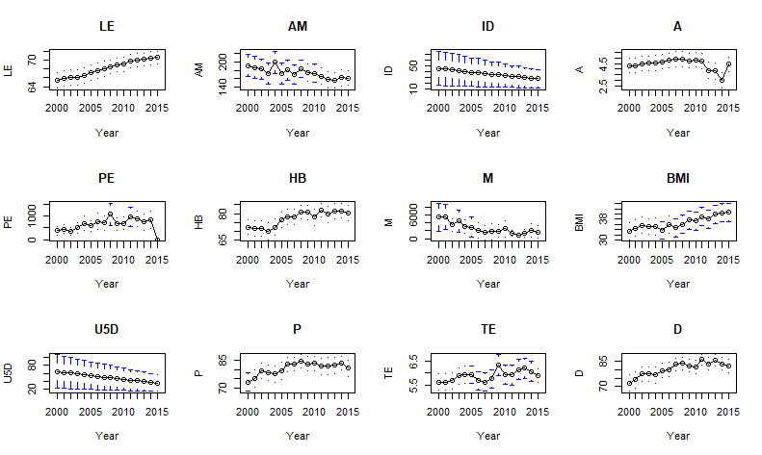
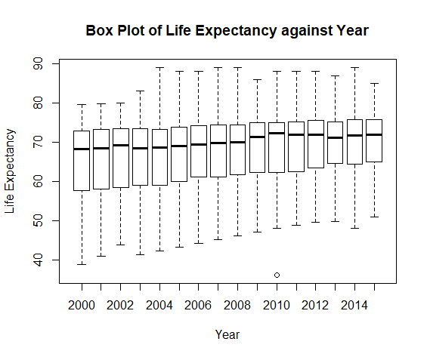
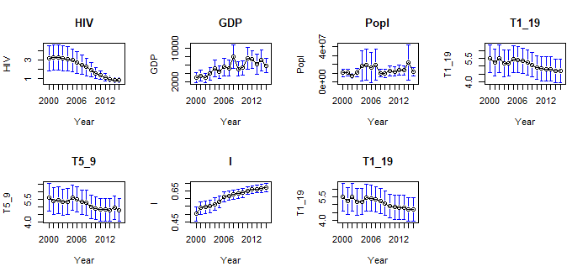
DATA EXPLORATION - gRaphical
Plot Means of each Variables against Years
Conclusion: Increase in Life Expectancy over last 16 years, with only 1 outlier in 2010

Slide 7
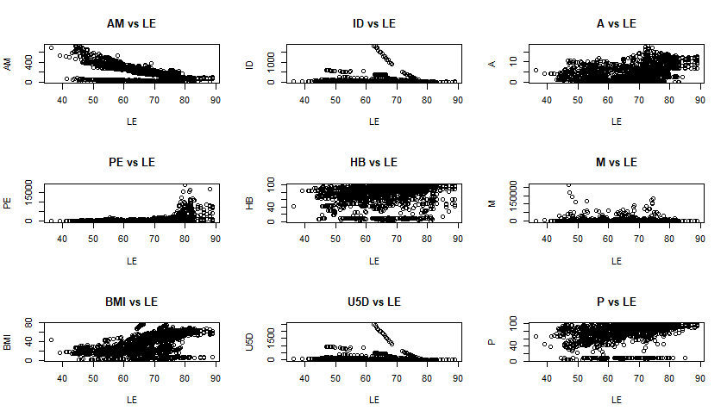
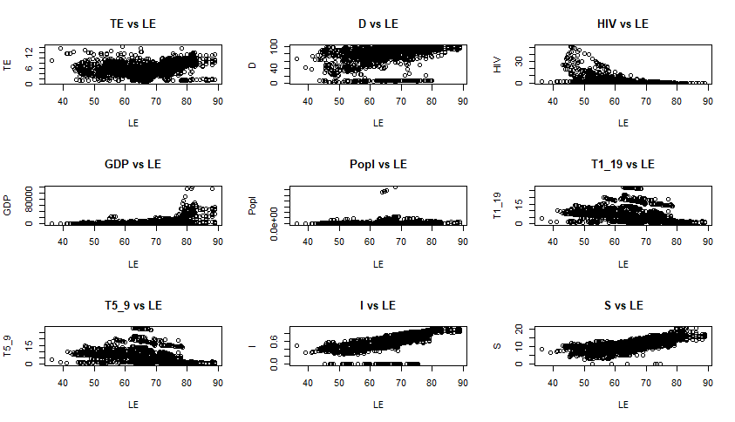
SCATTER PLOTs
Life Expectancy is more or less correlated with almost all the variables.
Very significant correlation of Life Expectancy with Adult Mortality, BMI, Deaths due to HIV, Income Consumption and Schooling.
Observed Scatter Plots of Life Expectancy and all other Variables

Slide 8
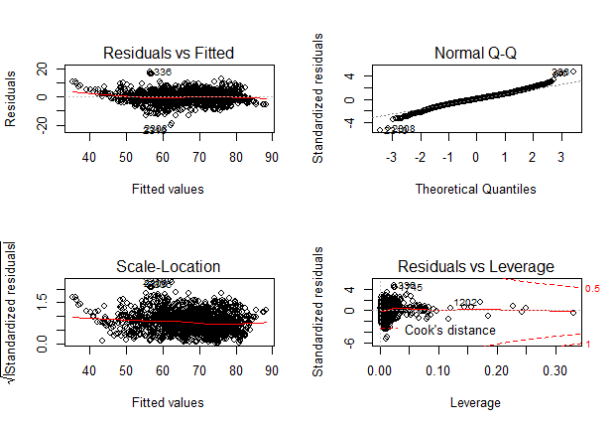
LINEAR MODEL APPLICATION
Random Partitioning of Data to Training Set and Testing Set
Training Set - 80% of observation: 1,702
Test Set – 20% observation: 426
Fitted Linear Model on Training Data where
Life Expectancy – Dependent Variables
All other Variables – Independent Variables
Result –
Life Expectancy and all other variables have linear relationship
Variables viz., AM, ID, A, BMI, U5D, P, D, HIV, GDP, I, S were significant
Linear Model Plot

Slide 9
Further model fitting
Multicollinearity is observed
Infant Death, % Expenditure > 150 VIF
Under age 5 Death, GDP > 9 VIF
MODEL 2
Applied PCA on all the variables
First 10 PCs account for 89.57% of total variation
Fitted Model on predicted PCs and removed the insignificant PCs
Final Model- 13 PCs as predictor variables
Adjusted R square = 83.14
Residual MSE = 18.53
Prediction on Testing set – MSE = 175.12
MODEL 1
Fitted Model after removing Variables with VIF>9
Removed insignificant variables viz., Population, Thinness
Final Model – Variables AM, A, HB, M, BMI, P, TE, D, HIV, S
Adjusted R square = 81.76
Residual MSE = 17
Prediction on Testing set – MSE = 16.51
MODEL 3
Applied Ridge Regression
Ridge Parameter – 0.00308
Final Model- Variables AM, ID, A, BMI, U5D, P, D, HIV, GDP, T1_19, I, S were significant.
Residual MSE = 11.77
Prediction on Testing set – MSE = 2675.69
Conclusion: MODEL SELECTED – MODEL 1

Slide 10
FINAL MODEL SELECTION
MODEL 4
Applied Variable Selection Method
Cross- checked with Step Regression
Final Model- Variables A, T1_19, P, D, GDP, BMI, ID, U5D, I, S, AM, HIV were significant
Adjusted R Square = 83.13
Residual MSE = 15
Prediction on Testing set – MSE = 15.96
Problems – Variable ID, T1_19 had very high VIF
Conclusion:
Model 1 and Model 4 gave similar Adjusted R square and MSE values.
Although Model 4 gave better R square and lesser MSE than Model 1, but the problem of multicollinearity still exists. Thus Model 1 is selected as the final model.
FINAL MODEL
LE = 0.469 - 0.0165AM - 0.0657A - 0.0123HB -0.002M + 0.056BMI + 0.246P + 0.956TE + 0.32D - 4.85HIV + 9.68I + 0.9S

Slide 11
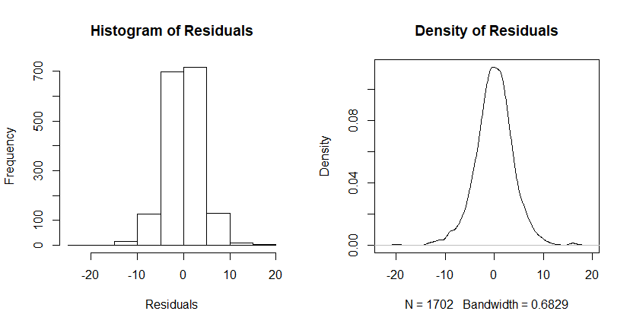
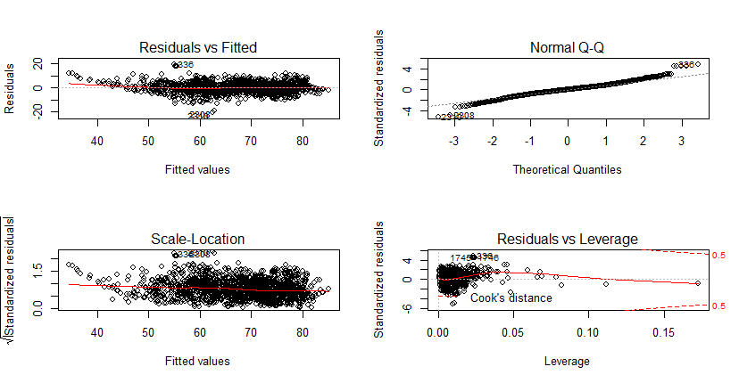
Validity of ASSUMPTION
Fig. 2.
Final Model satisfies both the assumption of
Homogeneity of Variance
Normality
Conclusion:
From Residual v/s Fit plot of Fig.1, the variance can be assumed to be constant.
From Fig.2, it can be assumed that the density of residuals from the model, follows Normal Distribution. Also, Shapiro Test accepts the normality assumption.
Fig. 1.
Model Plot

Slide 12
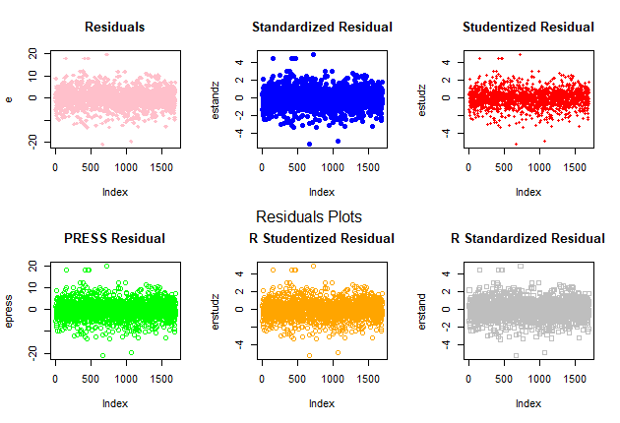
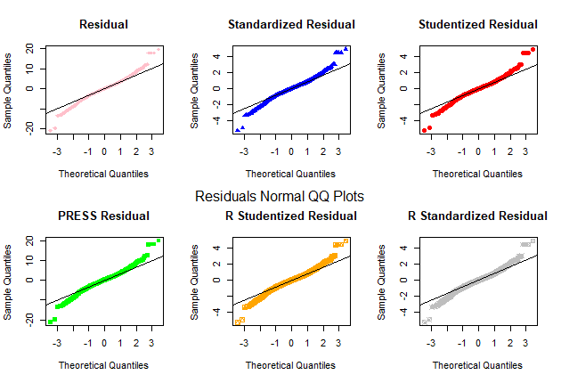
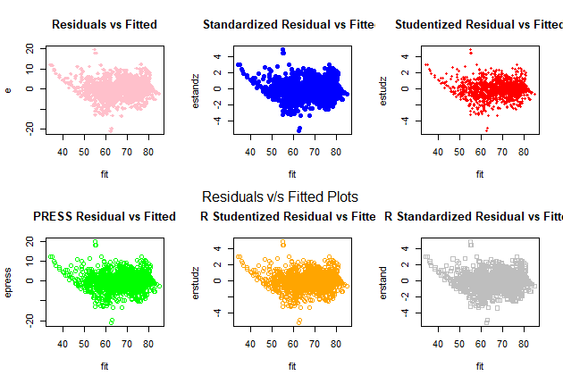
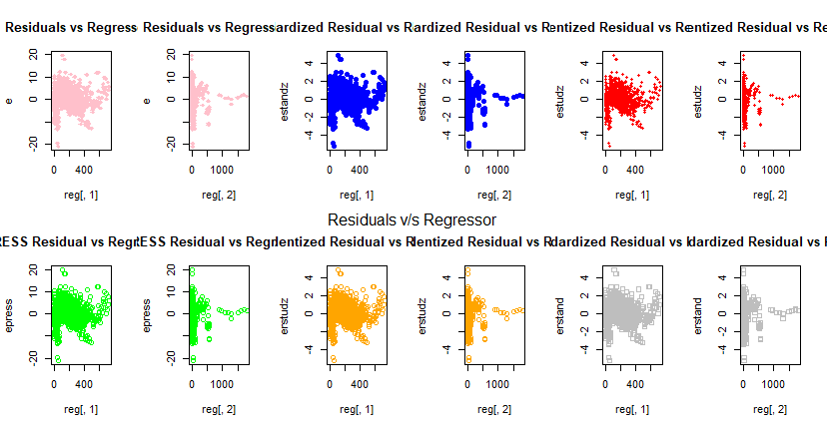
RESIDUAL ANALYSIS Plots

Slide 13
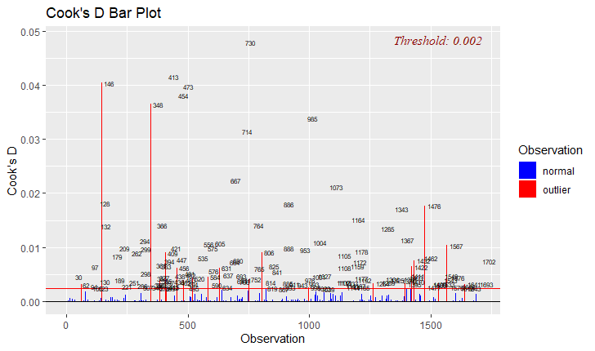
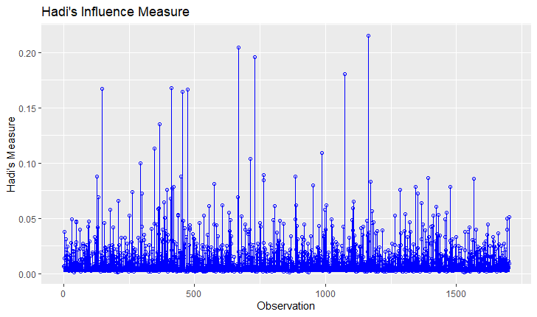
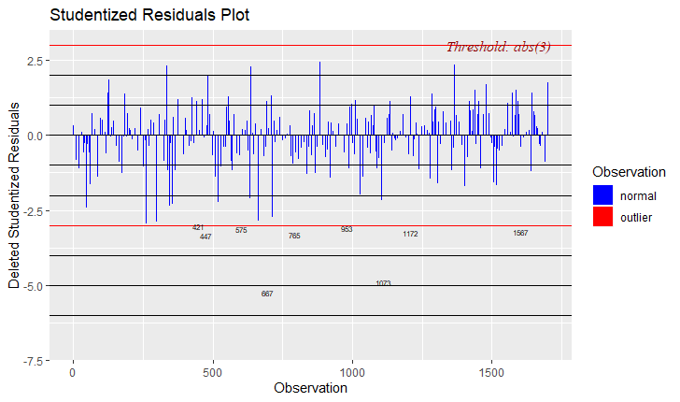
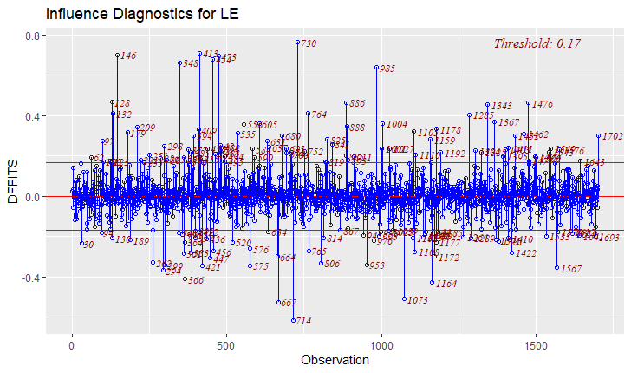
DRAWBACK – INFLUENCE OBSERVATIONS

Slide 14
FURTHER STUDIES
Remove the influence observations and fit the model
To fit a model where the Time Series nature of the data is considered
Further Analysis can be done considering the categorical variables as well viz. Country and Developing or Non Developing Status

Slide 15
THANK YOU!

